Slide 1



Workplace Activity Recognition System

Slide 2

Project Leadership
Rithiksharvesh KS rithiksharvesh27@gmail.com
https://www.linkedin.com/in/rithiksharvesh-ks-918a39285/

Slide 3

Contents
Business Problem
Project Overview
Methodology
Project Architecture
Data collection and Understanding
System Requirements
Annotation and preprocessing in Roboflow
Model selection
Visualization
Model Deployment
Challenges
Future Scopes
Notes:
Change

Slide 4

Business Problem
In most workplaces, traditional methods for tracking employee performance, such as manual reporting or invasive monitoring tools, are often ineffective, time-consuming, and can lead to employee dissatisfaction due to concerns over privacy. These methods either fail to provide accurate, real-time insights into how employees spend their time or create a sense of distrust between employees and management.
The challenge is to develop a system that automatically recognizes and categorizes workplace activities in real-time, providing managers with actionable insights to improve task management, identify inefficiencies, and optimize overall productivity. At the same time, the system must respect employee privacy, ensuring that it doesn’t infringe on personal boundaries or compromise morale.

Slide 5
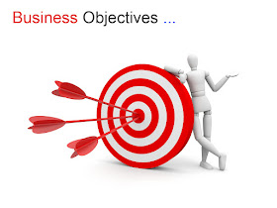
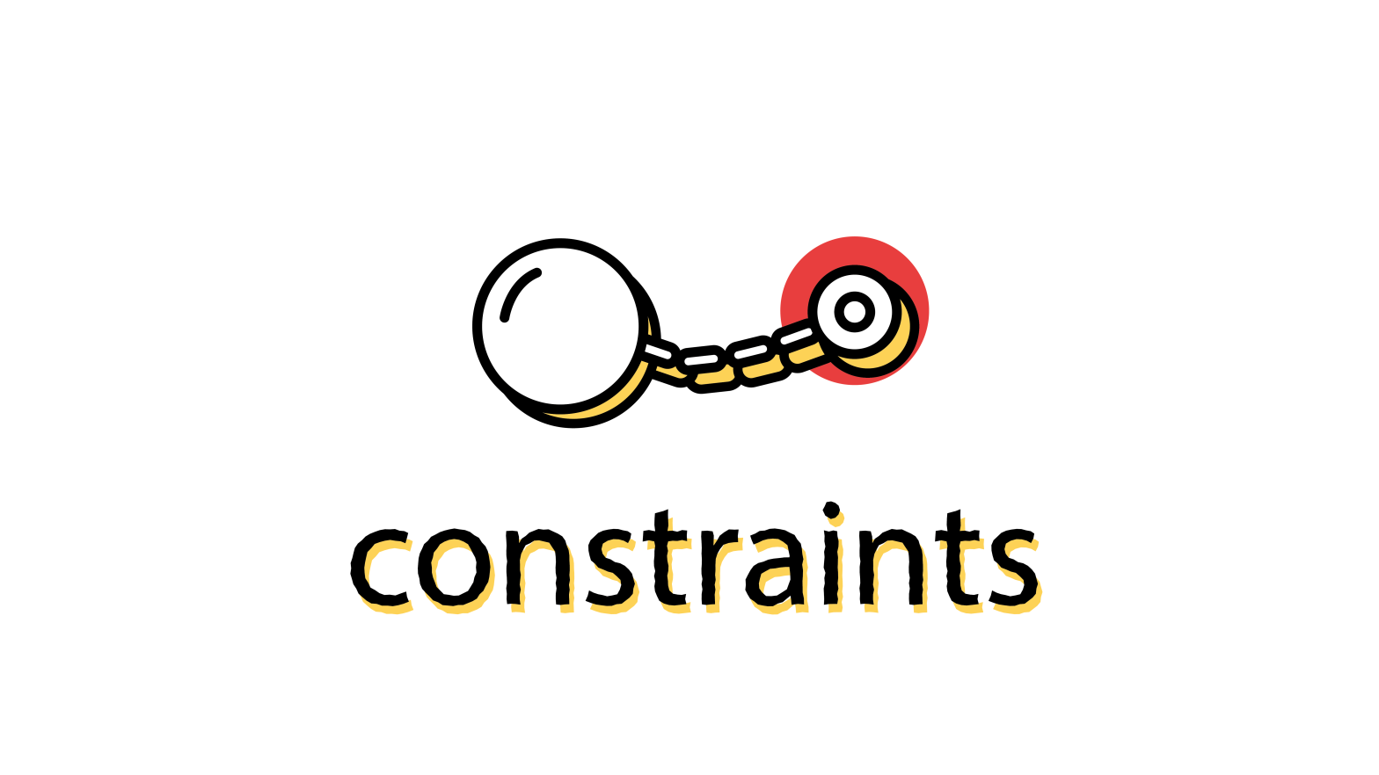
Business Objective and Constraints
Business Objective:
To accurately monitor and classify employee activities in real-time, enhancing productivity and optimizing task management for improved organizational efficiency.
Business Constraints:
The system must respect privacy, be cost-effective, accurate, and scalable, while ensuring employee acceptance, real-time processing, and compliance with data security regulations.

Slide 6
Project Overview and Scope
Project Overview:
The Workplace Activity Recognition System seeks to enhance workplace productivity by accurately identifying employee activities (such as idle, working, or empty chair) using annotated image and video data. Leveraging machine learning models, the system classifies activities in real-time, offering valuable insights into employee engagement and task management.
Project Scope:
Data Collection & Annotation: Gather and label images/videos showcasing various workplace scenarios.
Model Development: Train machine learning models using YOLOv8 and YOLOv11 for classifying activities.
Model Evaluation & Optimization: Assess model performance and refine it for optimal deployment.
Deployment: Deploy the model in a local environment for real-time activity recognition.
Final Presentation & Documentation: Deliver a detailed review and handover, including complete documentation.

Slide 7
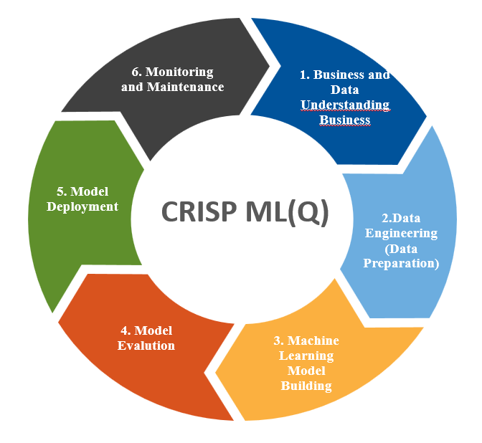
CRISP-ML(Q) Methodology
There are six stages of CRISP-ML(Q):

Slide 8
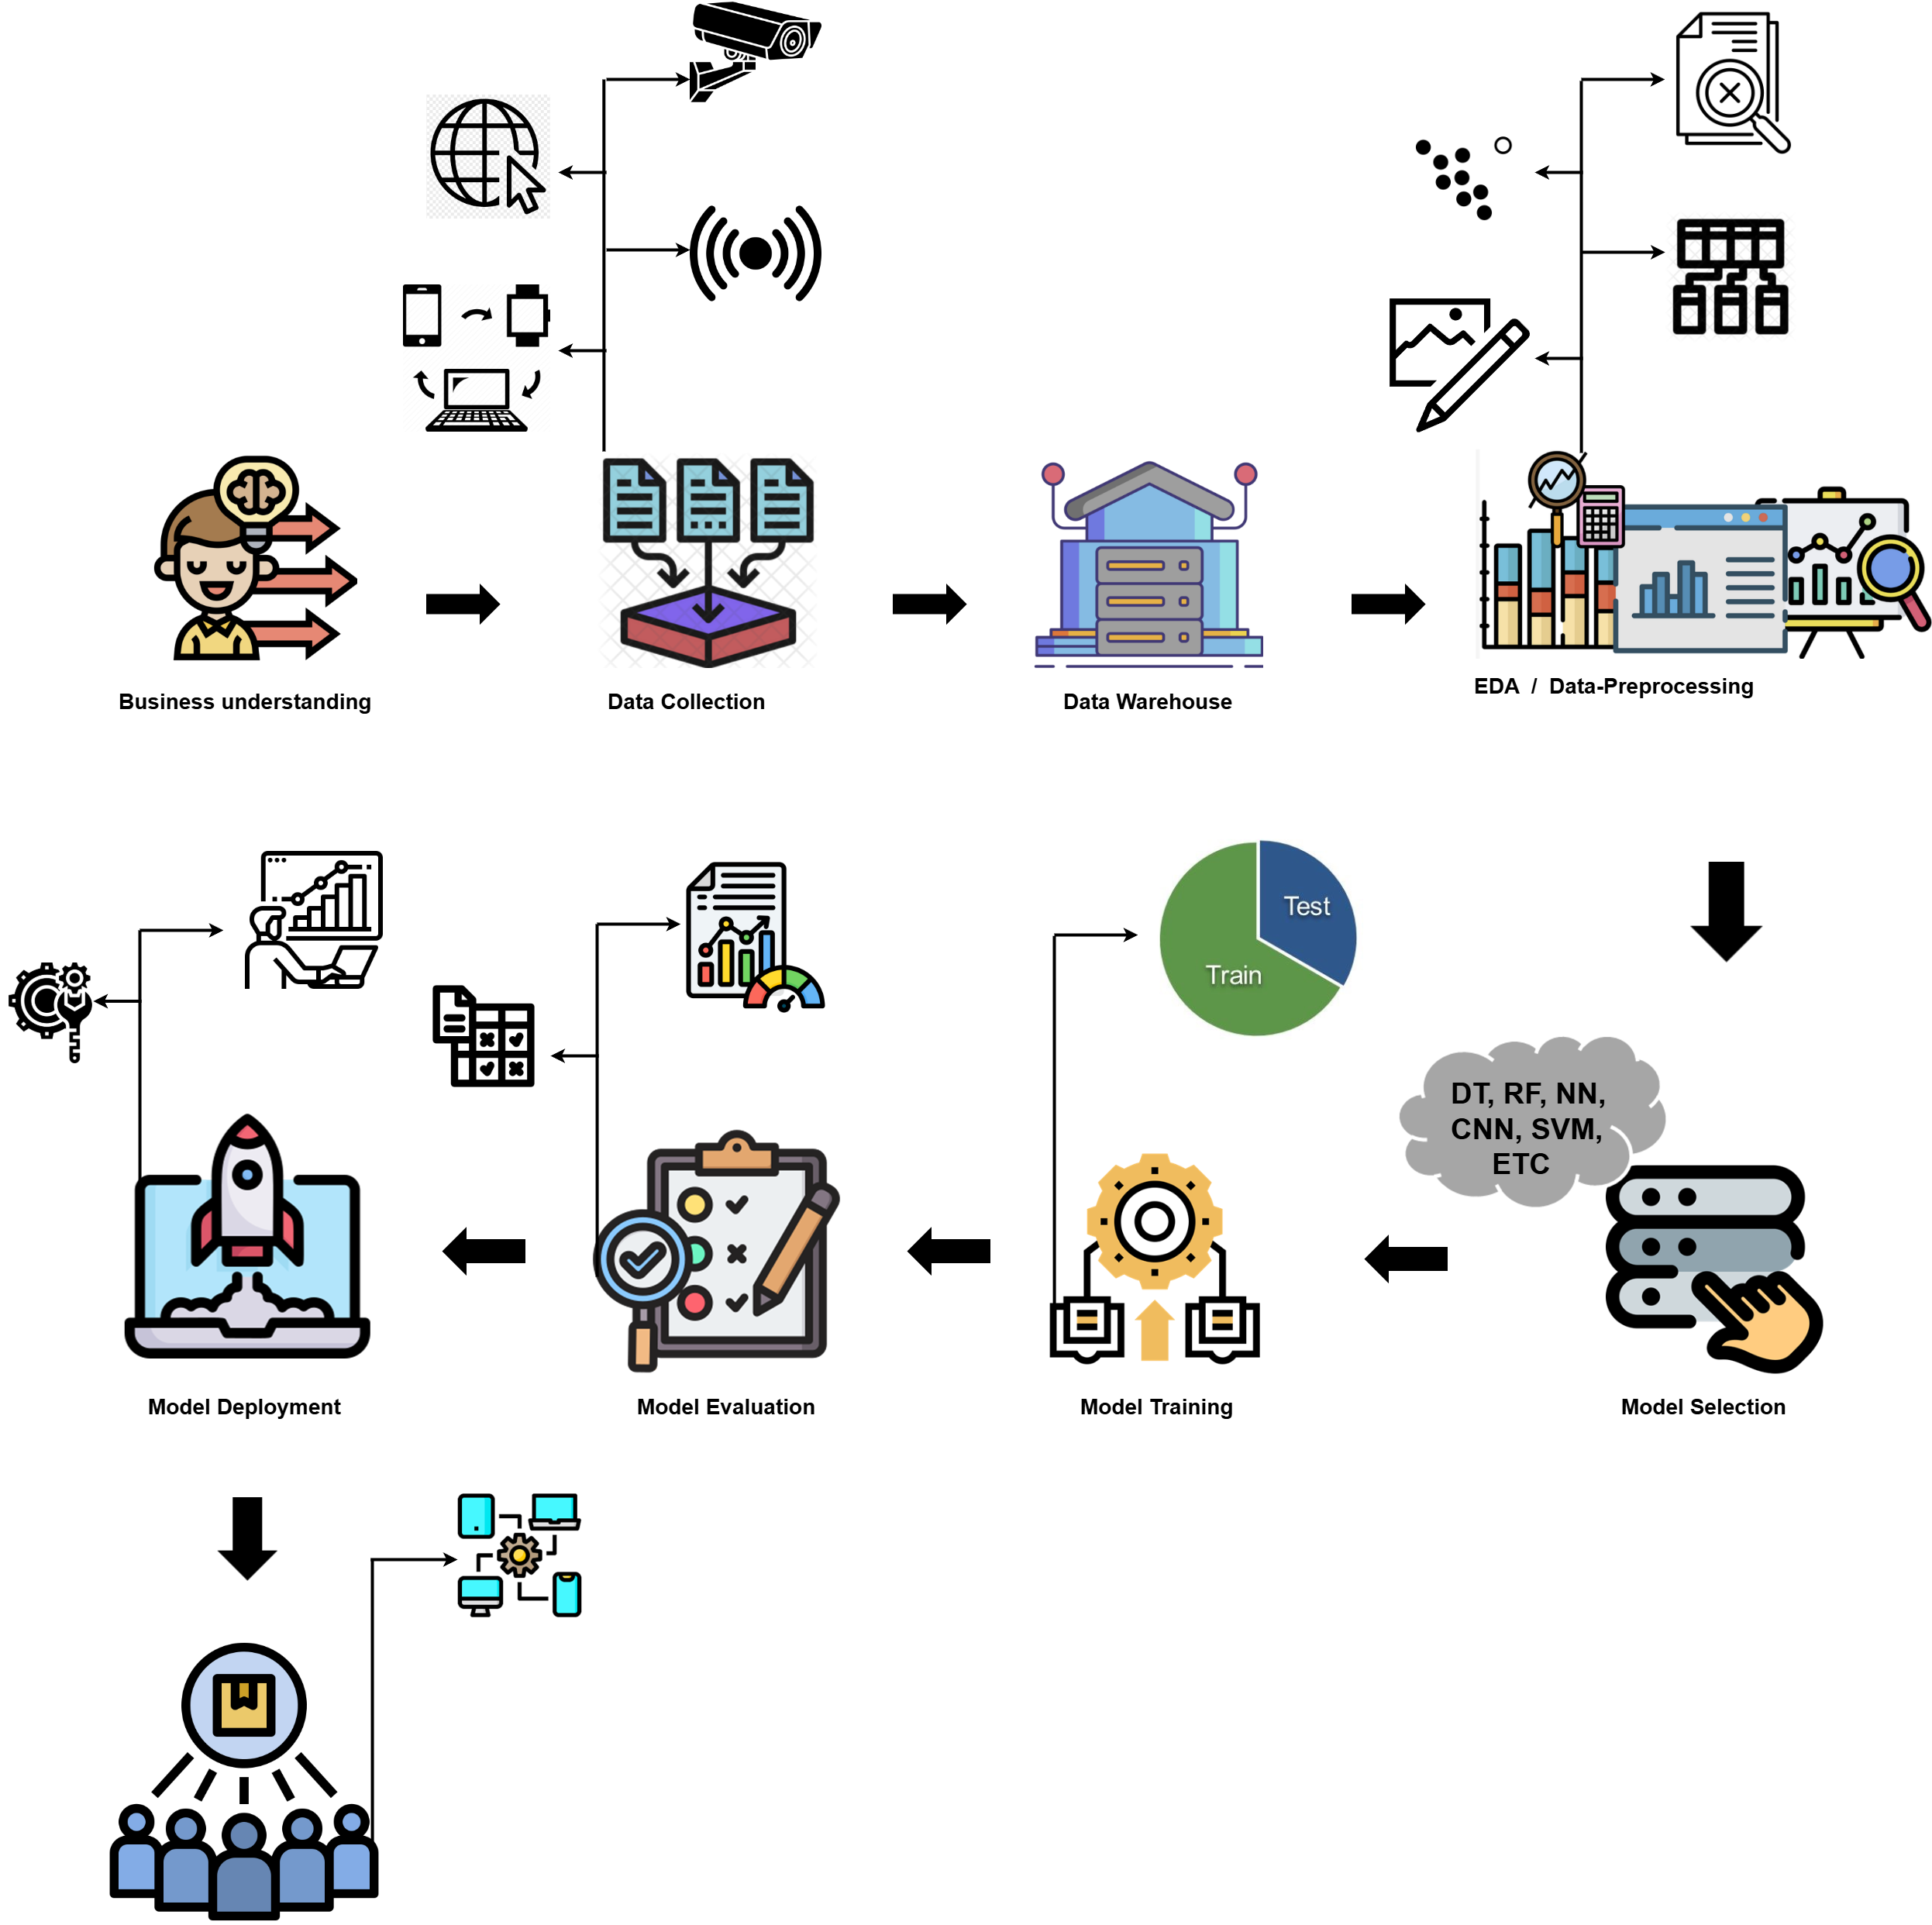
Project Architecture

Slide 9
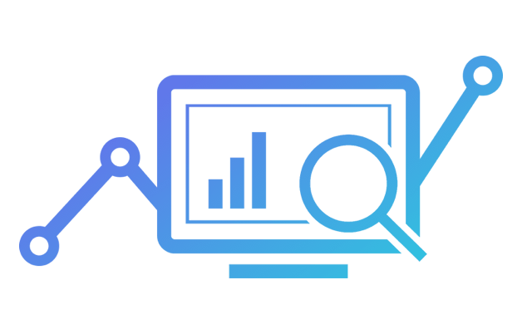

Data Collection and Understanding
In this project, data collection involves gathering videos and images from workplace environments to represent various employee activities, such as working, idle, or when the chair is empty. The collected data should cover a range of work scenarios and environments to ensure that the model can generalize across different settings. This includes capturing different lighting conditions, workspaces, employee movements, and behaviours.

Slide 10

Data Information
Data Sources
Annotated workplace images and videos (representing Idle, Working, and Empty Chair activities) were collected and preprocessed using Roboflow.
Dataset Details
Total Images: 2,067 (YOLOv8), 2,112 (YOLOv11)
Total Instances: 3,527 (YOLOv8), 3,184 (YOLOv11)
Classes
Idle: Instances where employees appear to be inactive or unproductive.
Working: Instances where employees are actively engaged in tasks.
Empty Chair: Represents an unoccupied workstation.
Format
The data was exported in YOLOv8 and YOLOv11 formats for training the models.

Slide 11

System Requirements
Hardware Requirements
Colab Runtime: NVIDIA T4 GPU (provided by Google Colab).
RAM: 12GB+ (Colab Pro/Pro+ for extended memory if needed).
Storage: Cloud storage integration (e.g., Google Drive) for dataset and model checkpoints.
Software Requirements
Operating System: Managed via Google Colab environment.
Programming Language: Python 3.7 or higher.
Libraries and Frameworks:
PyTorch , Ultralytics
Roboflow (for annotation and preprocessing)
Streamlit (for deployment)
OpenCV, Numpy, Pandas, Matplotlib.
YOLO Frameworks: YOLOv8 and YOLOv11.
Additional Tools
Annotation Tool: Roboflow for bounding box annotations.
Deployment: Local Streamlit application post-training.
Google Drive: For dataset storage and results.

Slide 12
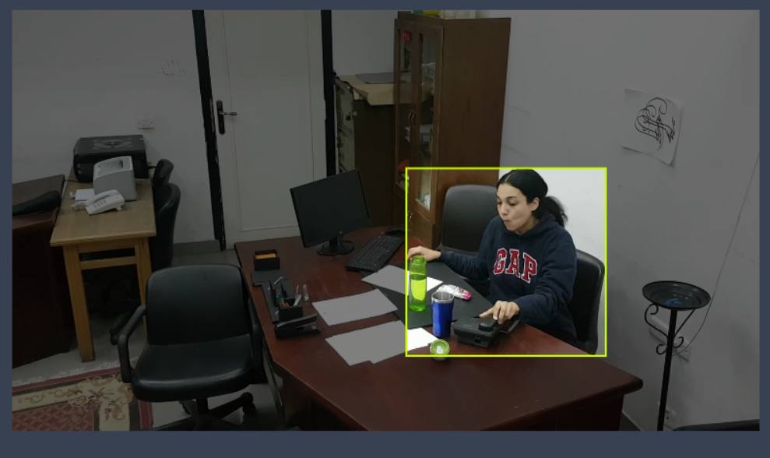
Annotations and Preprocessing in Roboflow
1. Purpose of Annotation
- Labeling workplace activities (Idle, Working, Empty Chair) with bounding boxes for accurate model training.
2. Annotation Process
- Used Roboflow to annotate 2,067 images (YOLOv8) and 2,112 images (YOLOv11) across three classes.
3. Preprocessing Steps
- Performed resizing, augmentation (e.g., rotation, scaling), and normalization to enhance dataset diversity and model generalization.
4. Export Format
- Exported the annotated dataset in YOLOv8 and YOLOv11 formats for compatibility with training frameworks.

Slide 13
Model Selection
The model selection should focus on achieving high accuracy in object detection and activity classification in real-time. YOLO (You Only Look Once) frameworks are ideal for this use case due to their speed, accuracy, and efficiency in handling real-time tasks.
YOLOv8: Prioritized for faster inference and real-time performance.
YOLOv11: Focused on achieving higher accuracy and robustness
Models used:
YOLOv8-S (Small): For faster training and inference with smaller models.
YOLOv8-N (Nano): Optimized for low-compute environments, offering the fastest inference.
YOLOv8-M (Medium): Balanced performance and speed for moderate-resource environments.
YOLOv11-S (Small): Lightweight and optimized for quicker training and deployment.
YOLOv11-N (Nano): Focused on real-time inference in low-resource systems.
Notes:
EDA is used for seeing what the data can tell us before the modeling task.
Change

Slide 14

Model Building and Model Evaluation
Model building:
Dataset Preparation
Model Selection
Model Training
Transfer Learning (if needed)
Model Evaluation:
Performance Metrics:
Precision: Measure the accuracy of activity classification.
Recall: Evaluate how well the model identifies all relevant instances.
F1-Score: Balance between precision and recall for a comprehensive evaluation.
mAP (Mean Average Precision): Assess detection performance across all classes.

Slide 15
Model Comparison
Model | Precision | Recall | mAP50 | mAP50-95 | Overall Accuracy (mAP50)
YOLOv8n | 0.913 | 0.929 | 0.959 | 0.808 | 0.959
YOLOv8s | 0.925 | 0.922 | 0.958 | 0.811 | 0.958
YOLOv11n | 0.922 | 0.931 | 0.963 | 0.805 | 0.963
YOLOv8m | 0.911 | 0.921 | 0.950 | 0.794 | 0.950
YOLOv11s | 0.925 | 0.922 | 0.958 | 0.811 | 0.958
Other models like YOLOv11n have slightly higher mAP50 (0.963), YOLOv8s provides a balanced performance across all metrics, especially excelling in precision and mAP50-95, making it a reliable and well-rounded choice.
YOLOv11s has the same values as YOLOv8s across all metrics in the table but YOLOv8s may be more lightweight, faster, or easier to deploy than YOLOv11s.
Notes:
Keep observations

Slide 16
Best Model
Model:
YOLOv8s
Best Metrics:
Precision: 0.925
Recall: 0.922
mAP50: 0.958
mAP50-95: 0.811
Overall Accuracy (mAP50): 0.811
Epochs: 10
Batch Size: 16
Highest Precision and Recall for "Empty Chair" class (Precision: 0.96, Recall: 0.95).
Overall, YOLOv8s achieved the best balance between precision and recall across all classes (Idle, Working, Empty Chair), with high mAP values.
Notes:
Add graphical

Slide 17
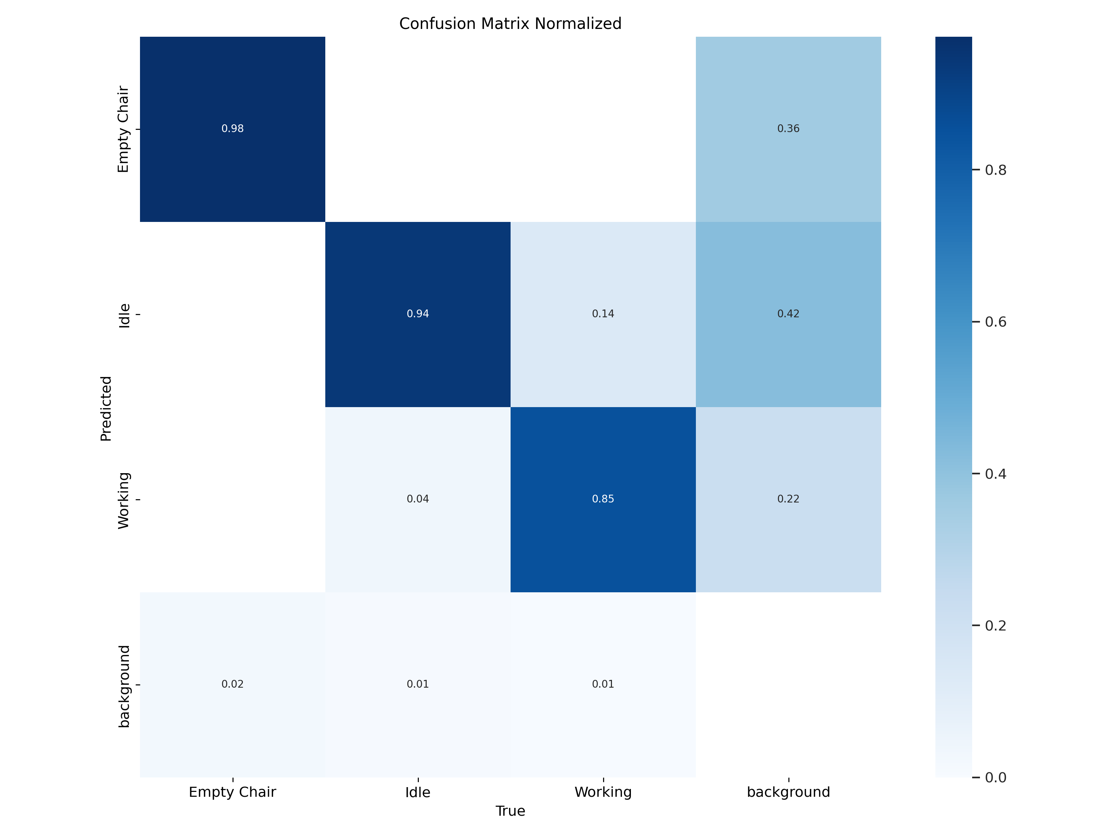
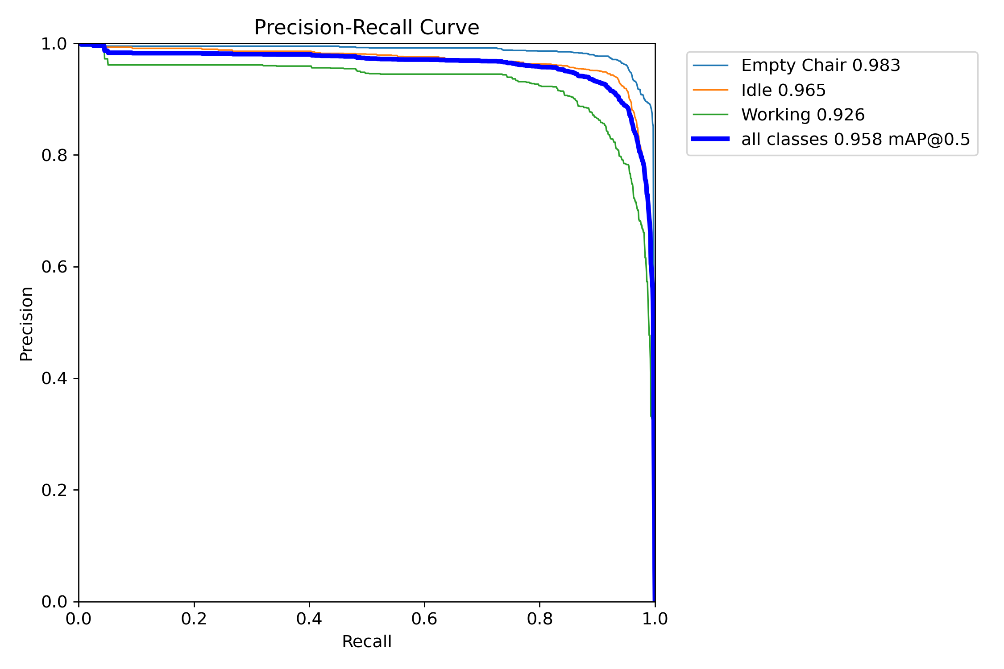
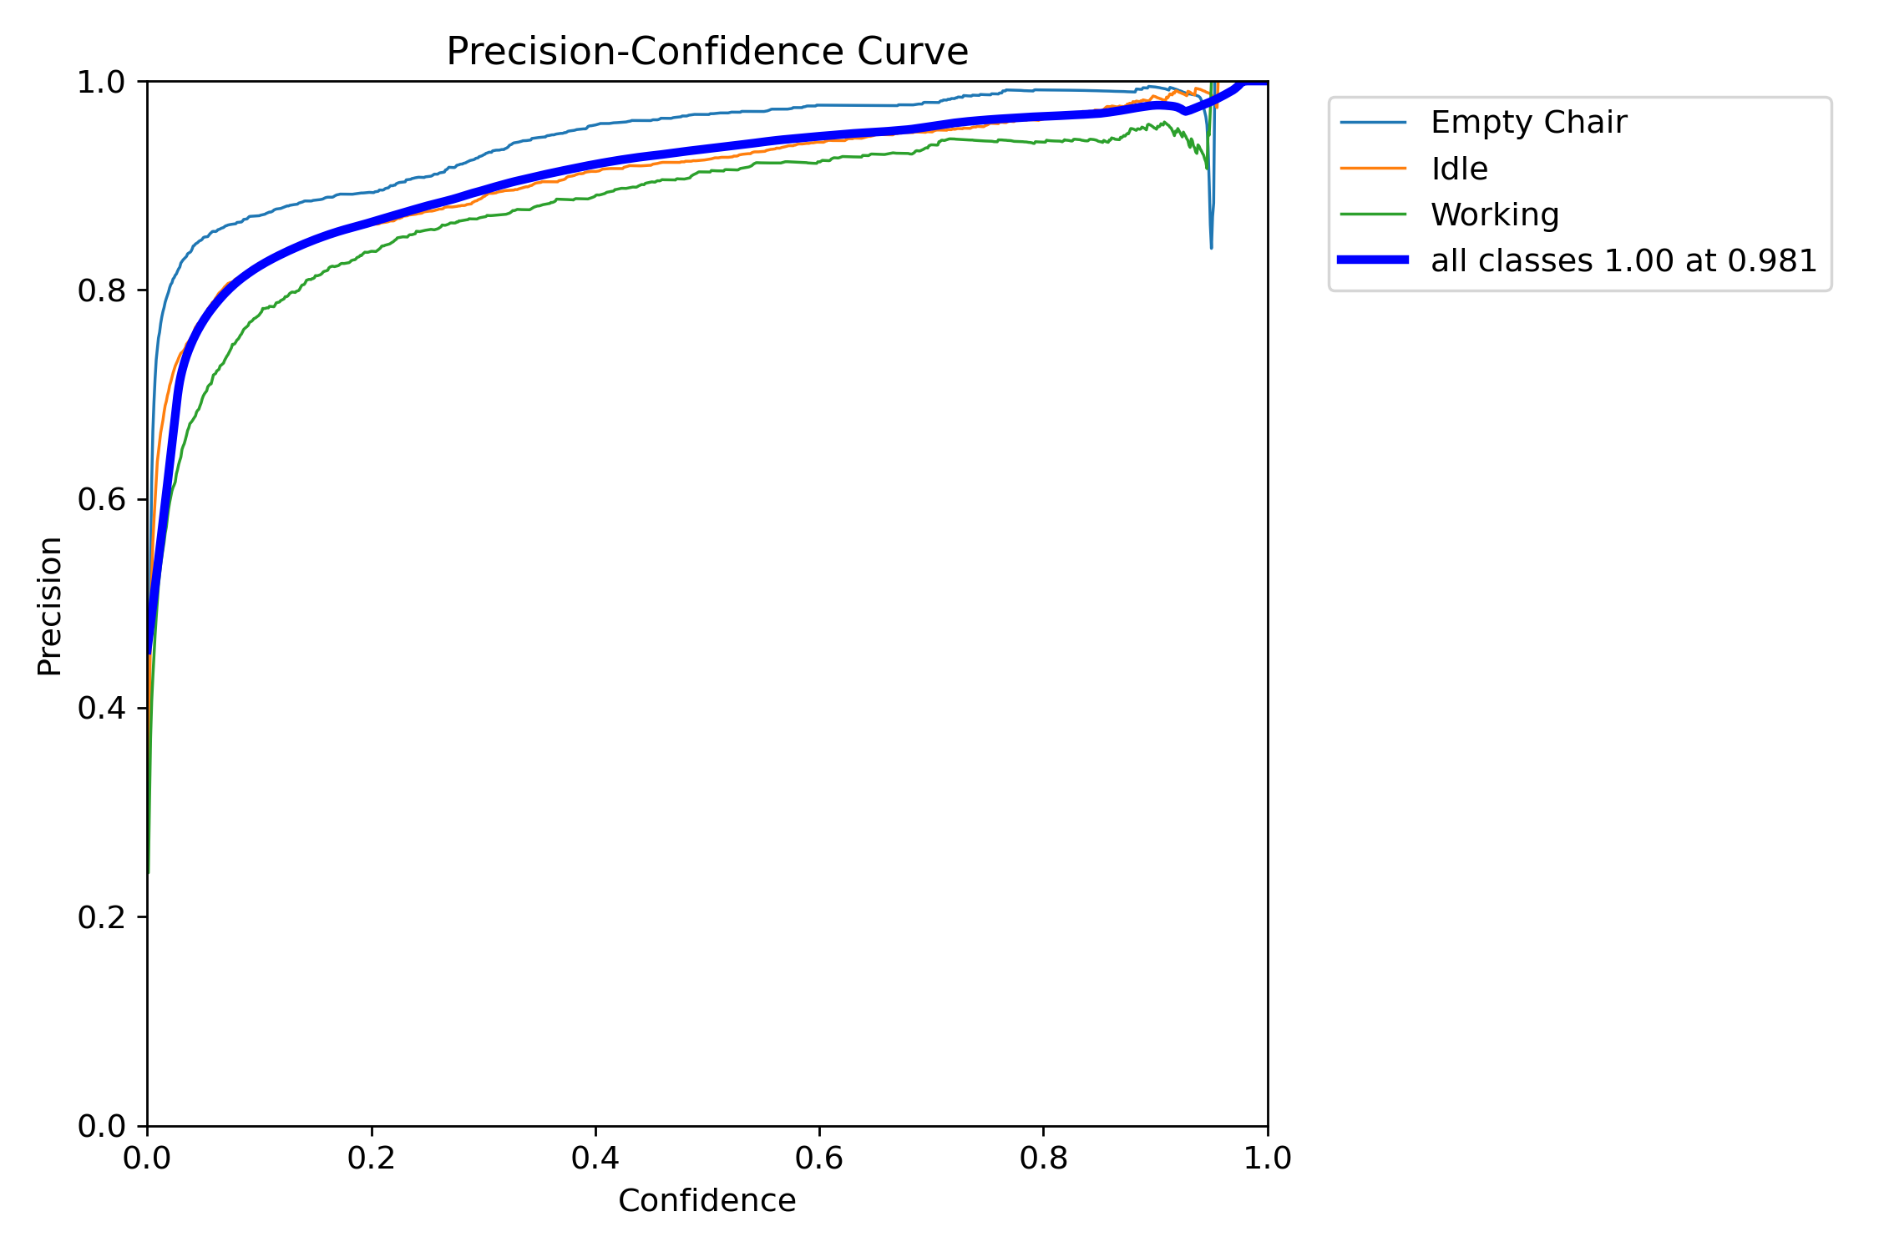
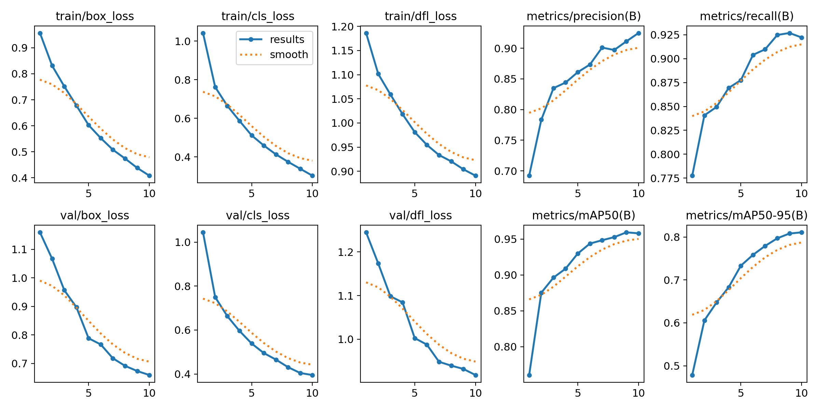
Model Visualization
Notes:
Add graphical

Slide 18
Model Deployment
Deployment Platform:
Streamlit was used for deploying the Workplace Activity Recognition System model.
Deployment Process:
Streamlit App Development:
Developed an interactive web application to enable real-time visualization of model predictions and integrate the trained YOLO model into the Streamlit app for easy deployment and testing.
User Interface (UI):
A simple, user-friendly interface enables users to upload images or videos for real-time activity classification, displaying predictions with confidence scores for the three classes: Idle, Working, and Empty Chair.
Model Inference:
The app leverages the deployed YOLO model to classify workplace activities from uploaded images or videos,
providing real-time inference for dynamic activity recognition in the workplace.
Notes:
classification is the task of predicting a discrete class label. Regression is the task of predicting a continuous quantity.
What is classification techniques in machine learning?
The Classification algorithm is a Supervised Learning technique that is used to identify the category of new observations on the basis of training data. In Classification, a program learns from the given dataset or observations and then classifies new observation into several classes or groups.
What is regression techniques in machine learning?
Regression is a technique for investigating the relationship between independent variables or features and a dependent variable or outcome. It's used as a method for predictive modeling in machine learning, in which an algorithm is used to predict continuous outcomes.

Slide 19
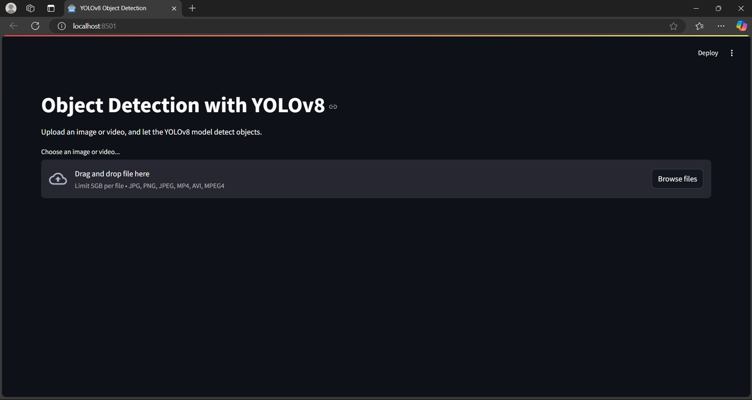
Model Deployment -UI
Notes:
Why Random Forest Regression is good?
A Random Forest Regression model is powerful and accurate. It usually performs great on many problems, including features with non-linear relationships
How is XGBoost different from random forest?
One of the most important differences between XG Boost and Random forest is that the XGBoost always gives more importance to functional space when reducing the cost of a model while Random Forest tries to give more preferences to hyperparameters to optimize the model..
n_estimators — the number of decision trees you will be running in the model

Slide 20
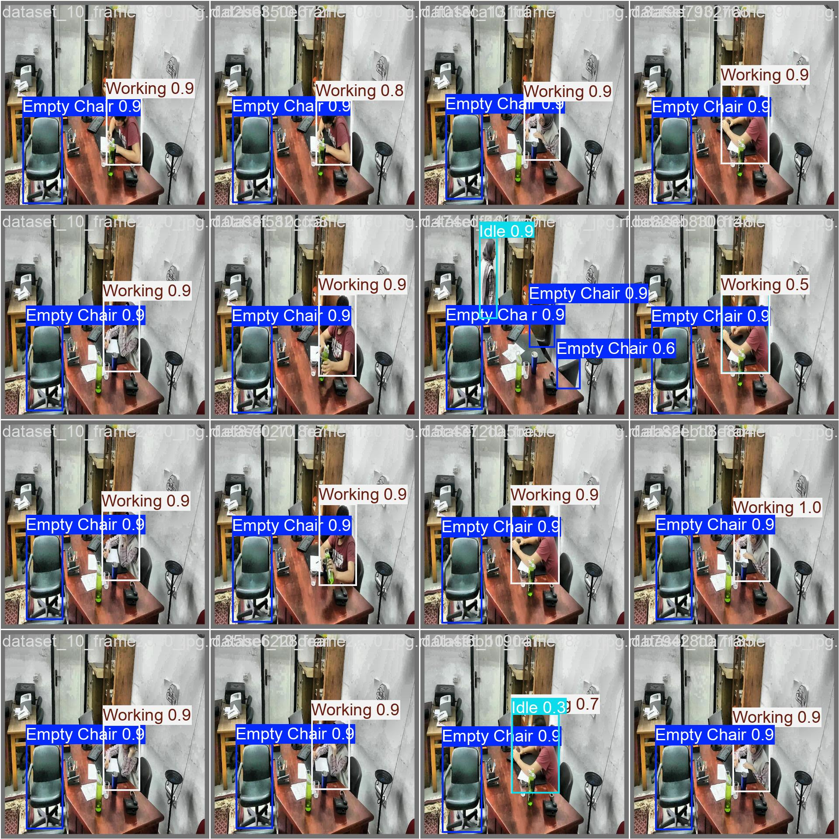
Output-UI

Slide 21

Video-Output

Slide 22
Challenges
Data Collection & Annotation:
Gathering diverse, representative workplace scenarios and ensuring accurate labeling of activities (Idle, Working, Empty Chair).
Model Performance:
Balancing real-time speed with high accuracy, handling edge cases like overlapping objects and low-light conditions
.
Privacy Concerns:
Addressing employee privacy and complying with data protection regulations during data collection and deployment.
Hardware Limitations:
Ensuring efficient real-time inference with limited computational resources for local deployment.
System Integration:
Seamlessly integrating the model into the app and ensuring compatibility with existing workplace infrastructure.
Generalization & Overfitting:
Preventing overfitting and ensuring the model generalizes well across different environments and scenarios.

Slide 23
Future Scopes
Enhanced Activity Recognition:
Expanding the system to classify additional activities beyond Idle, Working, and Empty Chair, such as meetings, breaks, or collaborative work.
Real-Time Analytics Dashboard:
Developing a dashboard to visualize employee engagement and productivity trends based on real-time activity data.
Integration with Workplace Tools:
Integrating with existing workplace management systems (e.g., task management or attendance systems) for streamlined workflow.
Scalability:
Scaling the solution to accommodate larger workplaces or multiple locations, supporting diverse environments and workforce sizes.
Employee Insights & Feedback:
Using AI-driven insights to provide feedback to employees, enhancing task efficiency and overall workplace satisfaction.
Enhanced Privacy Features:
Implementing advanced privacy-preserving techniques, ensuring ethical data usage and compliance with data protection regulations.

Slide 24
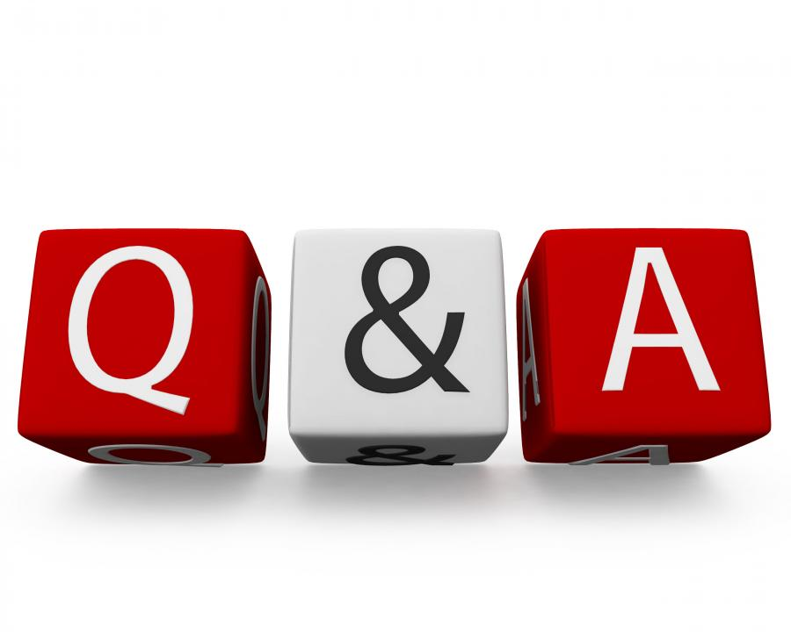
Queries ?

Slide 25
